Slide 1
E-LEARNING RESOURCE
Team Members
Ram Bhupal - bhupal9490791218@gmail.com
Rambabu Cholla - rambabucholla123@gmail.com
Sai Charan Reddy - rachamallusaicharanreddy@gmail.com
Sammed - sammedrangole18@gmail.com
Santwashree Chakraborty - santwashree2016@gmail.com

Slide 2
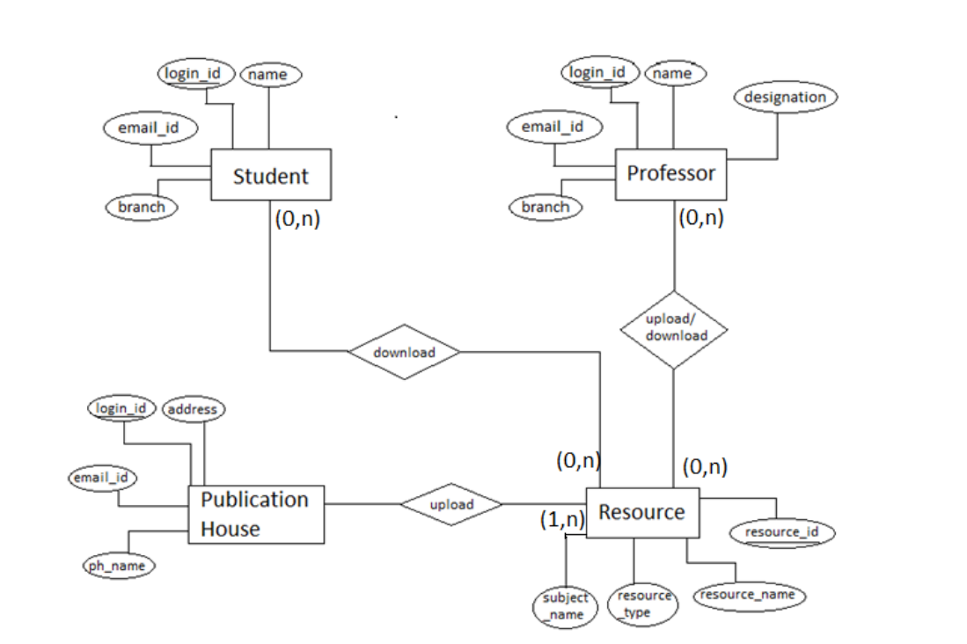
ER diagram

Slide 3
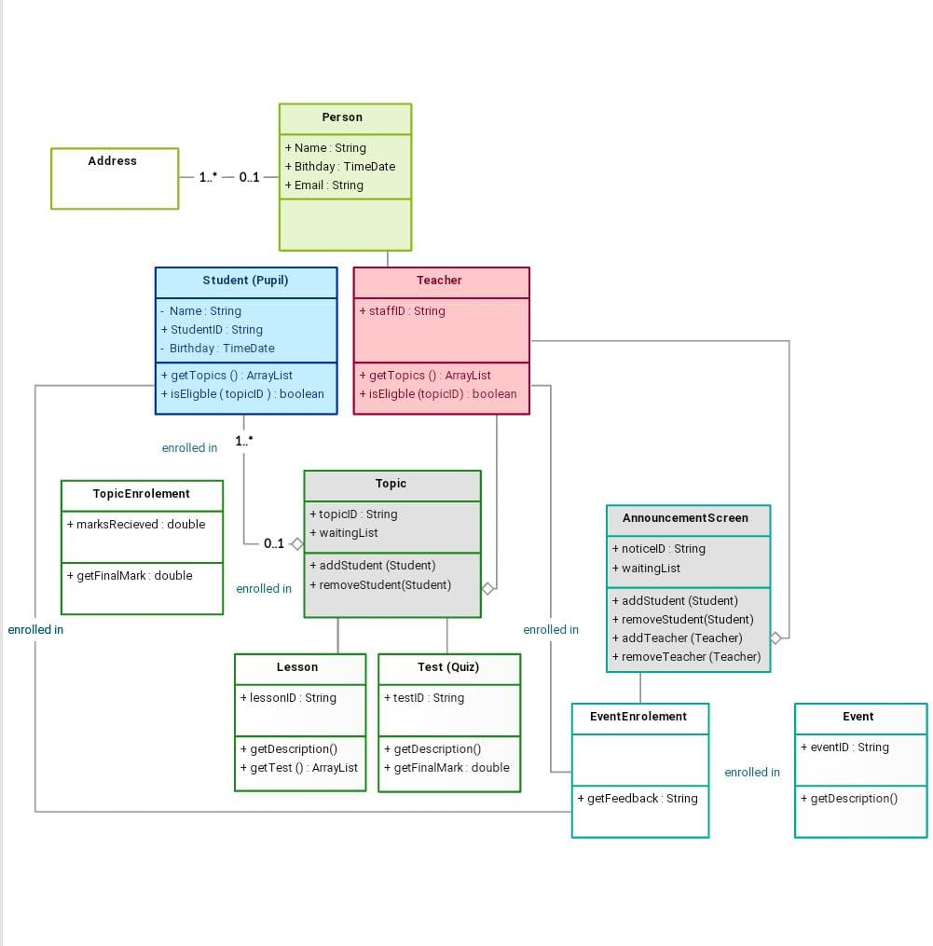
Class diagram

Slide 4
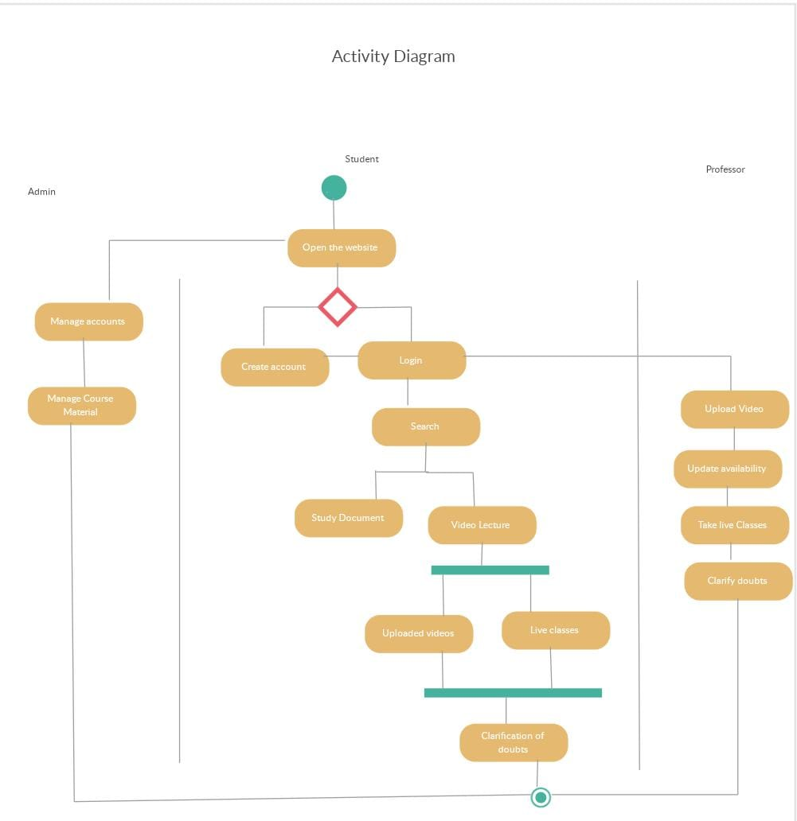
Activity diagram

Slide 5
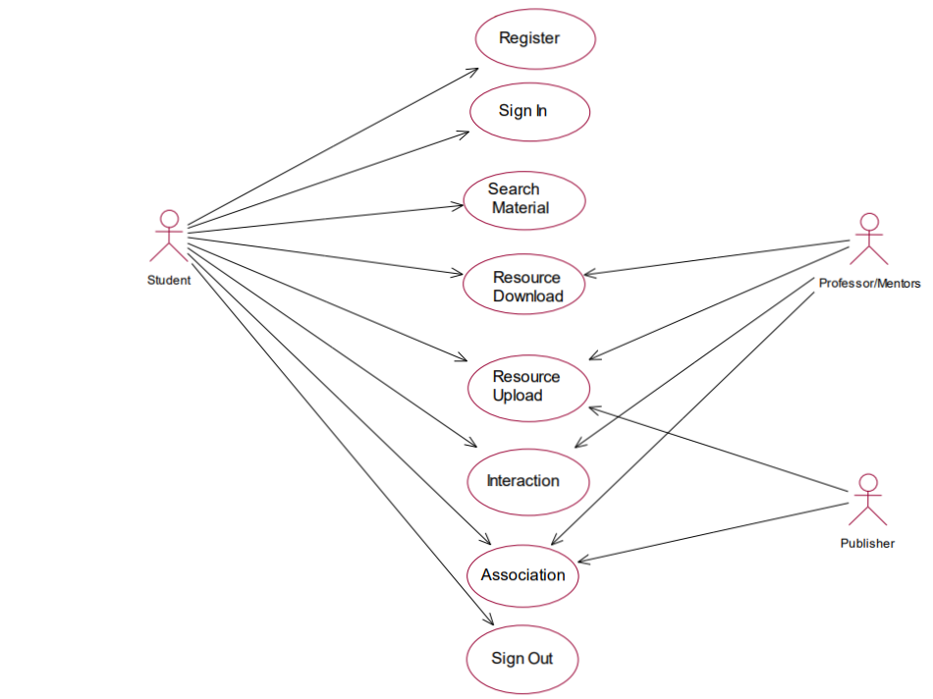
use case diagram

Slide 6
Advantages of e-learning
Saves time and money
Better retention
Personalized learning
Cost-effective
Environment-friendly

Slide 7
Disadvantages of E-learning
Lacks social interaction
Inaccessible to others
Cheating is unavoidable
Requires self-motivation and proper time management skills
Focuses more on theory

Slide 8
THANK YOU

